Slide 1

Taylor Swift Spotify Data Set
Presented By Amie, Arjay, Kat, Siobhan and Bolima

Slide 2
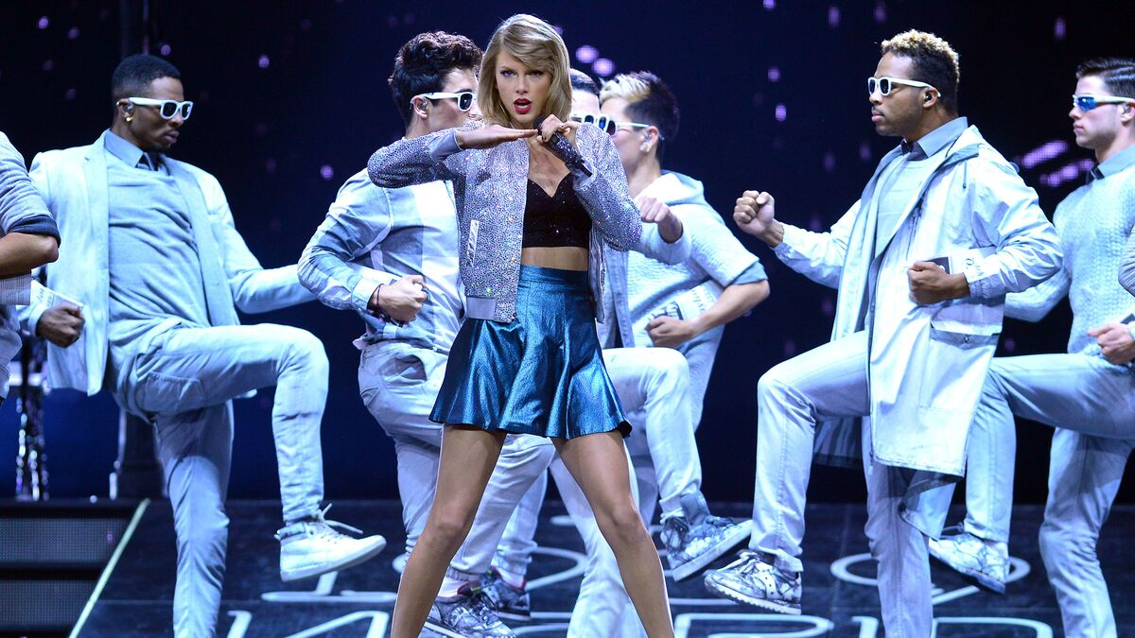
The Data
Our original data set contained 18 columns of data and 487 rows of data.
We broke this into 3 tables for our SQLite database to include a table of just unique song names, a table of just unique album names, and a table of all data.
Variable | Meaning
name | the name of the song
album | the name of the album
release_date | the day month and year the album was released
track number | the order the song appears on the album
id | the Spotify id for the song
uri | the Spotify uri for the song
acousticness | 0.0-1.0 scale, describes whether a track is acoustic
danceability | 0.0-1.0 scale, describes how suitable a track is for dancing
energy | 0.0-1.0 scale, perceptual measure of intensity and activity
instrumentalness | 0.0-1.0 scale, predicts whether a track contains no vocals
liveness | 0.0-1.0 scale, detects the presence of a live audience in the track
loudness | The overall loudness of a track in decibels (dB)
speechiness | 0.0-1.0 scale, describes how much spoken word in the track (vs. singing)
tempo | The overall estimated tempo of a track in beats per minute (BPM)
valence | 0.0-1.0 scale, describes the musical positiveness conveyed by a track
popularity | the popularity of the song from 0 to 100
duration_ms | The duration of the track in milliseconds

Slide 3


The Flask App
Our app opens up to a default page noting the routes the app can take
Our app pulls data from a SQLite Database and a local JS file to populate the routes
These Routes Are:
Songdata – list of just the unique songs
Albumdata – list of just the unique songs
Metadata – list of all data entries
Songs – Song Dashboard
Albums – Album Dashboard
I’m also a problem…
It’s me, hi, I’m the problem it’s me.

Slide 4
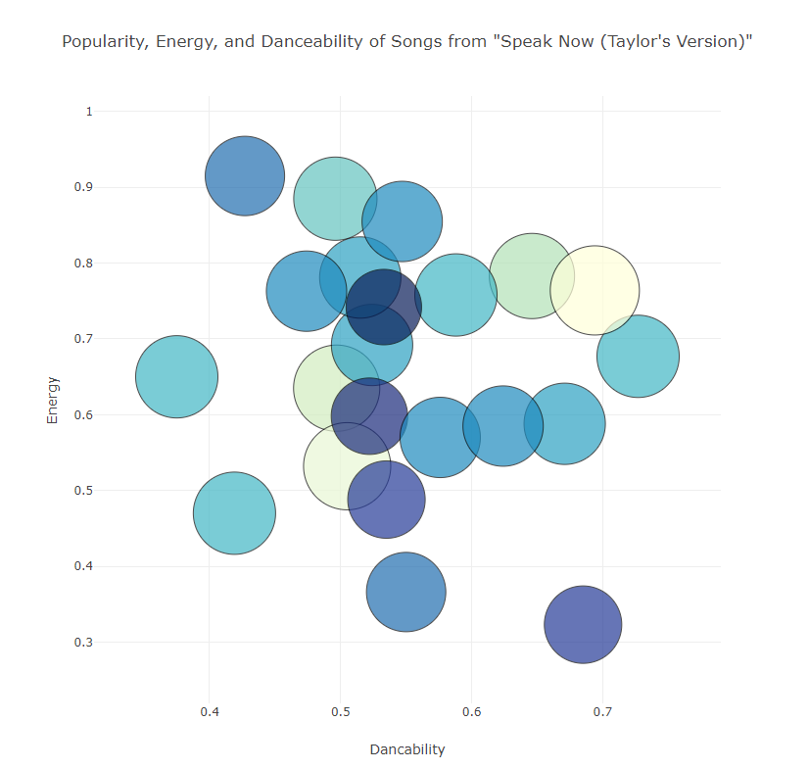
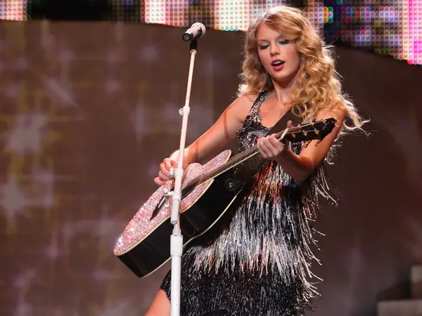
Data Analysis 1) Comparing songs’ Popularity, Danceability, and Energy
The bubble chart compares a song’s popularity (bubble size AND COLOR) with DANCEABILITY and energy of the song.
DANCEABILITY - Detects the RHYTHM AND TEMPO. 0.0-1.0 SCALE (LEAST TO MOST).
- POPULARITY IS A VALUE 0 TO 100
Energy - Energy is a measure from 0.0 to 1.0 and represents a perceptual measure of intensity and activity.
- Typically, energetic tracks feel fast, loud, and noisy.

Slide 5
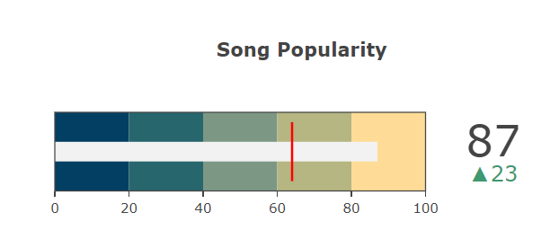
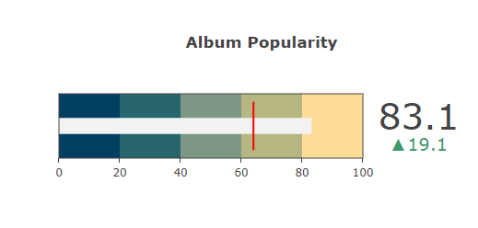
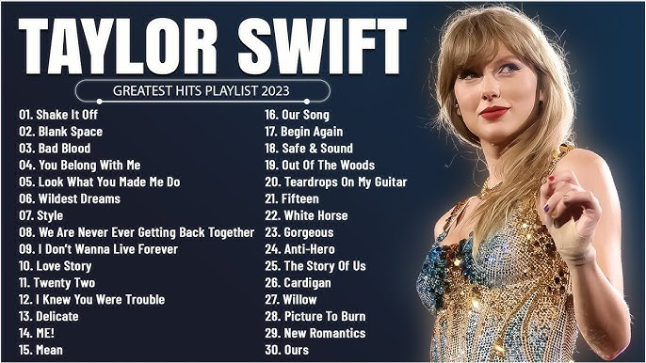
Data Analysis 2) Analyzing popularity in terms of song and Album
The SONG bullet chart shows the popularity of each song OR ALBUM that’s selected.
Delta – compares the song to the mean popularity score of all her songs which is 64.
The Album bullet chart shows the popularity of that album.

Slide 6
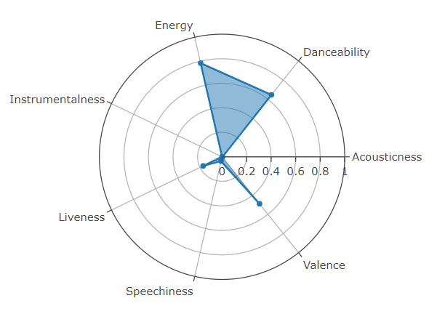

Data Analysis 3) Analyzing Elements of the Song
The polar radial chart shows ratings for 7 DIFFERENT MUSICAL aspects of Taylor's songs.
METRICS INCLUDE: Acousticness, valence, speechiness, liveness, instramentalness, energy, and dancability
EACH MEASUREMENT FOLLOWS A 0 TO 1 SCALE

Slide 7

Use cases for our App
If you want to know which of Taylor’s albums are the best (and which are not so great).
If you want to know which of her songs are the best.
If you want to know possible reasons why a song or album is more popular than another based on its musical qualities.
If you want to quickly identify a more “upbeat” popular song vs. a more “ballad” or calmer popular song.

Slide 8
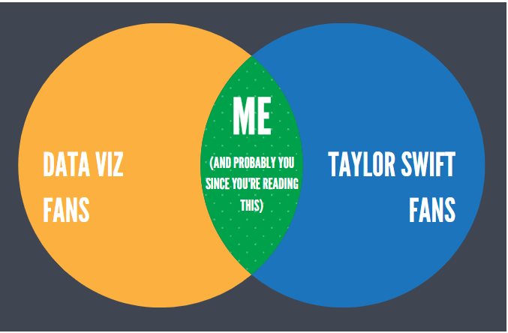
QUESTIONS?

Slide 9
Sources
https://www.kaggle.com/datasets/jarredpriester/taylor-swift-spotify-dataset/data

